Slide 1
Lunar Cycles & Human Behavior
Data Science Capstone Project
by Matthew E. Parker, PhD
Notes:
Hi, I’m Dr. Matthew Parker and today we will be exploring correlations between Lunar cycles and human behavior using Python. [NEXT SLIDE]

Slide 2



Project Overview
Abstract
Inspired by academic studies that have shown a regular increase in reported crimes during full moons, this project aims to investigate whether other human behavior is correlated to lunar phases.
Approach
Gather a year of tweets from Twitter for various keyword searches (>365,000 tweets)
Gather a year of financial data on a variety of stocks and currencies
Use Facebook Prophet modeling to examine correlation to lunar cycles
$ € ₿
Notes:
The inspiration for this project came from a recent news article claiming that reported crimes increase during full moons. This apparently is a hotly debated topic in academic circles, so I decided to explore for myself. To do so, I scraped a year’s worth of Twitter posts (1000/day for 365 days) and also scraped a year of daily financial data for various stocks and currencies. Then I modeled this data using Facebook Prophet. [NEXT SLIDE]

Slide 3
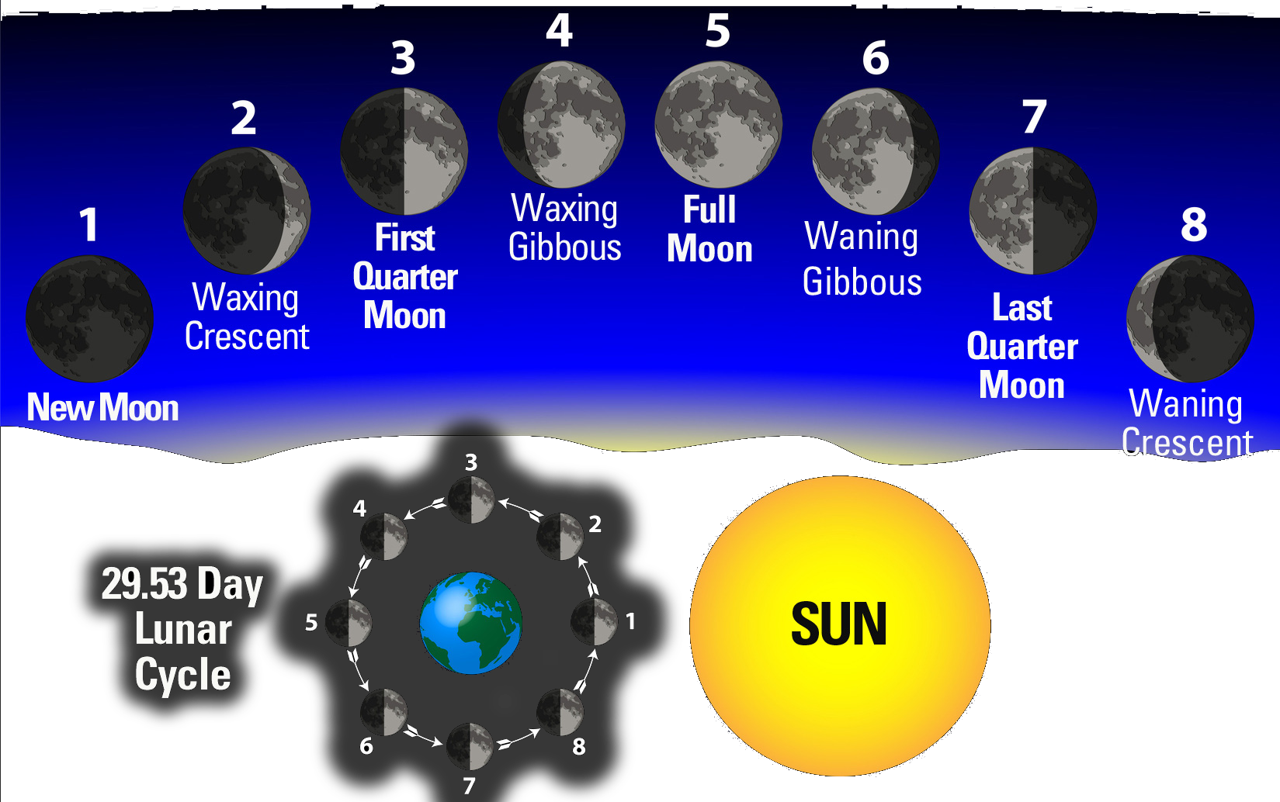
Lunar Phases
Important Notes on Lunar Phases
Lunar cycle lasts 29.53 days
Each major phase (bold) can appear to last 2-3 nights
Lunar phases only refer to how much light is reflected from the Moon
no relation to tidal/gravitational effects or to Moon’s proximity to Earth
First Full Moon of 2018 was January 2
Notes:
It’s important to note that lunar cycles do not perfectly match our calendar week and, observationally, each phase can appear to last 2-3 nights. Also, lunar phases have no relation to the moon’s distance to the Earth or any tidal or gravitational effects stemming there from. [NEXT SLIDE]

Slide 4
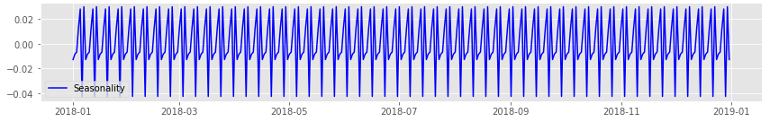
Methodology, 1
Twitter Sentiment Analysis
Scraped 1,000 tweets per day for 365 days of 2018
Repeated process for 7 different keyword searches
Used Natural Language Processing (NLP) to determine general sentiment of each tweet (positive / neutral / negative)
Modeled tweet sentiment with seasonal decomposition to detect whether any cycles existed
Revealed cyclical behavior on scale of 7.4 days and 29.5 days (major lunar phases & lunar month)
Notes:
After gathering tweets for seven keyword searches, I used Natural Language Processing to determine the overall mood of each tweet. Then, I employed seasonal decomposition to reveal the existence of cyclical behavior (seasonality) on the scale of 7.4 and 29.5 days, lining up perfectly with the lunar cycle. [mention regular peaks on graph] [NEXT SLIDE]

Slide 5
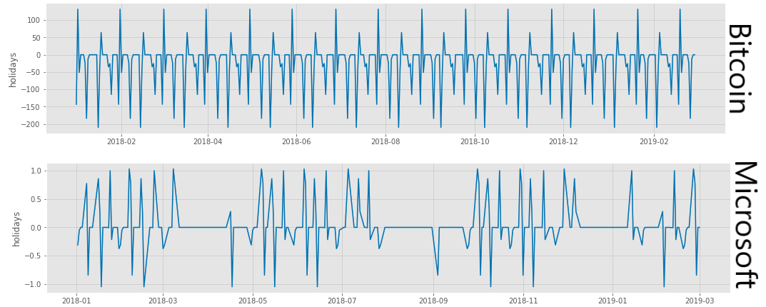
Methodology, 2
Analysis with Facebook Prophet
Incorporated FBProphet’s ‘holidays’ feature to separate lunar cycle effects from other seasonalities (work week, monthly, etc.)
Modeled financial data from various sources, as well as the various tweet data
All showed distinct seasonality correlating with lunar phases
Oddly, different stocks/currencies showed different seasonalities
Notes:
With seasonality confirmed, I continued my time-series analysis using Facebook’s powerful Prophet library. As suspected, stocks and currencies also exhibited seasonality tied to the lunar cycle. However, unlike with the twitter data, each stock or currency exhibited its own unique correlation to the cycles. [graph: here you can see how Bitcoin is generally spikes downward on lunar phase dates while Microsoft generally spikes upward] [NEXT SLIDE]

Slide 6
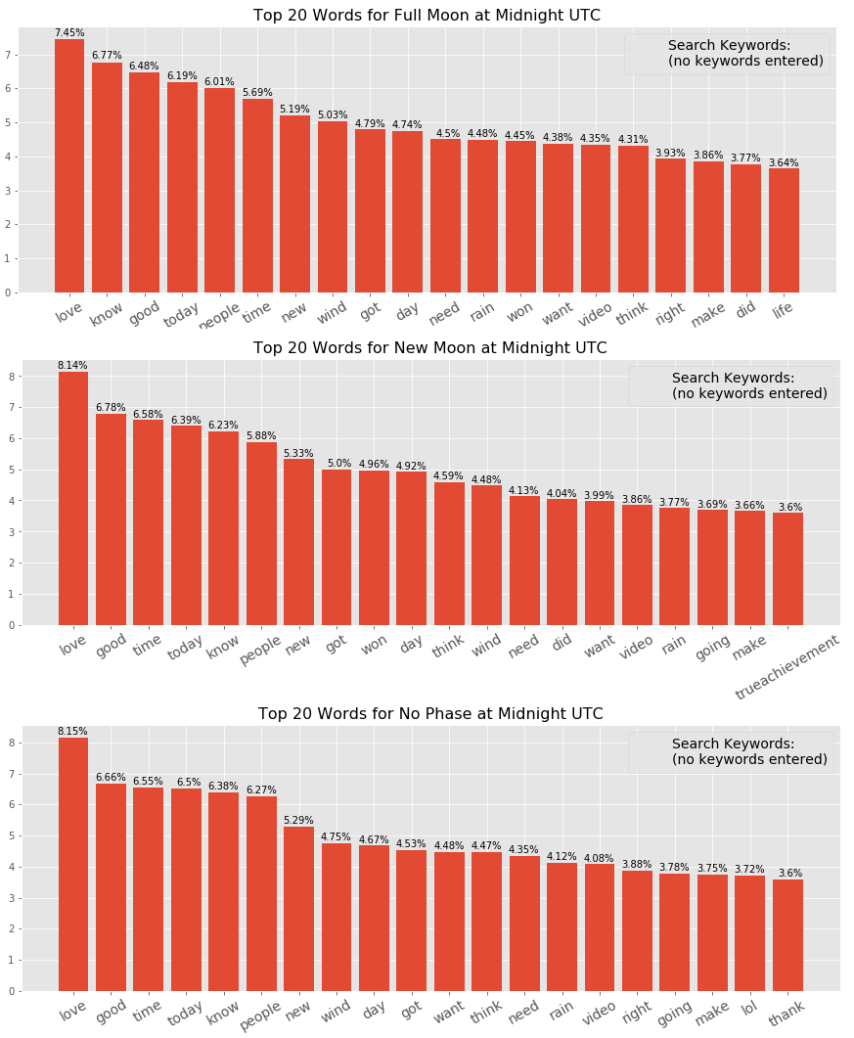
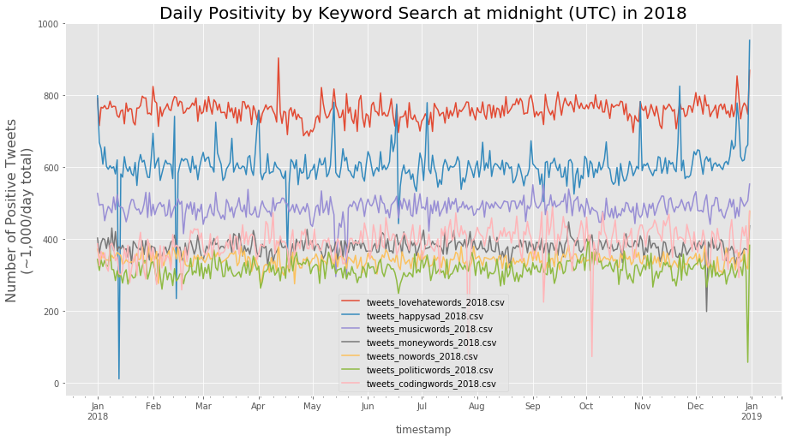
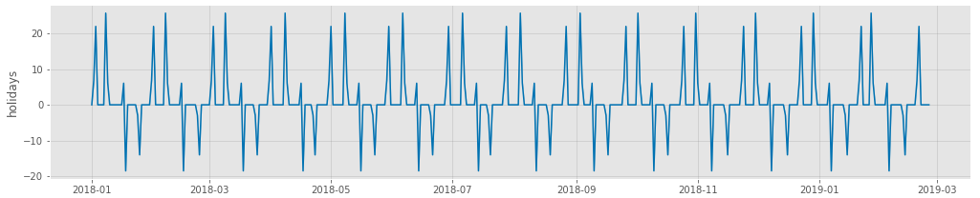
Exploring Twitter Sentiment
Notes:
Returning to the tweets, I sought other avenues for gleaning more information from the data through visualizations. [top right graph] The overall comparisons between the keyword searches were interesting for what they reveal about the general mood on those topics. [bottom right graph] Though each search displayed its own unique seasonality, this example shows the common trend of full and last quarter moons being the most positive and new and first quarter moons being the least positive. [left graph] Finally, histograms of word frequencies for different phase dates (and non-phase dates) revealed interesting shifts in word choice, though nothing overly alarming. [NEXT SLIDE]

Slide 7
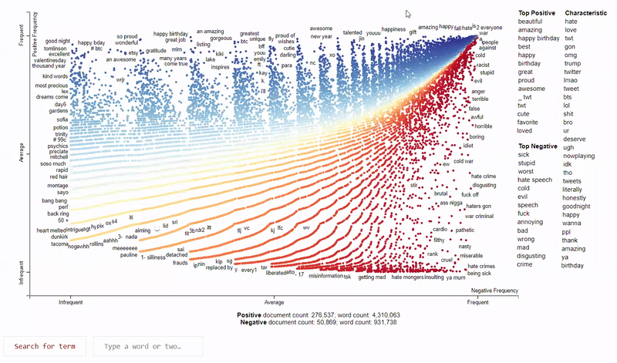
Visualizing with Scattertext
Notes:
The most fascinating visualization I generated was done with the Scattertext library, which displays the categorical relationships of textual data. The interactivity and keyword-searchability of this tool, as well as the functionality to output contextualizing snippets, promises to be very useful to researchers in the humanities, political science, government, social sciences, and likely a host of other fields. [NEXT SLIDE]

Slide 8
Take-aways & Recommendations
Lessons
Human behavior appears to have a small correlation to lunar cycles
Full Moon & Last Quarter Moon exhibit increased positivity
New Moon & First Quarter Moon exhibit increased negativity
Financial markets are not immune to lunar correlation, though +/- depends on stock/currency
Financial markets also exhibit tendency to immediately correct the day after a lunar phase
Recommendations & Future Research
Run models on multiple years of data, and larger volume of tweets throughout the day
Investors ought to take lunar cycles into consideration when building their forecasts & algorithms
The Scattertext library stands to be very useful in many fields of research and government
Notes:
In the end, human behavior does appear to have a small (~1% effect) correlation to lunar cycles. It is up to future researchers to explore what this correlation means and what mechanisms drive it. Perhaps with a much larger data set spanning a longer time span (and with much more processing power) deeper insights might be revealed. In the short term, I suspect that investors engaged in the burgeoning practice of algorithmic trading will be able to profit from incorporating lunar seasonality into their investment algorithms. [NEXT SLIDE]

Slide 9
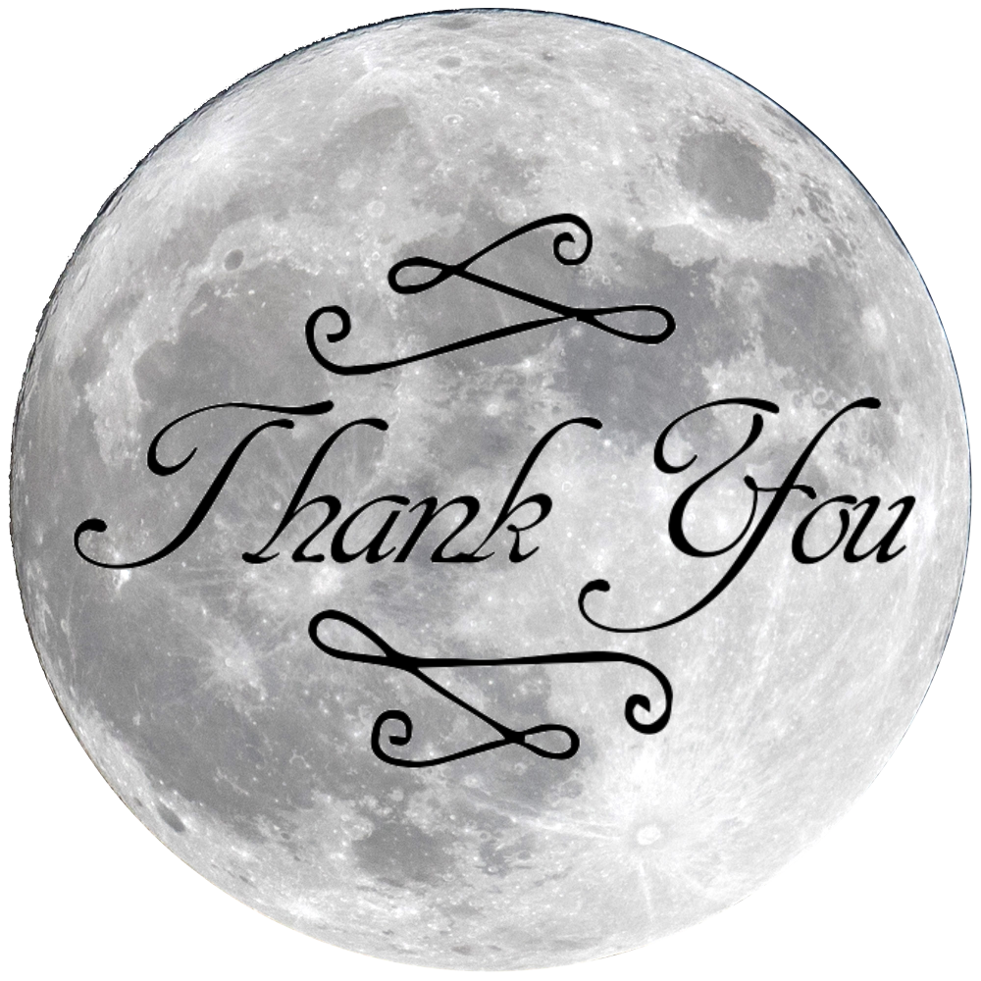
Thank you
Contact me at:
mattheweparker@gmail.com
Github:
https://github.com/magnawhale/capstone_project
Notes:
Thank you for your time.

